Slide 1

Coffee chain launch
- Location analysis using Foursquare API
- Demographic exploration using clustering technique

Slide 2
Analytical process/methodology
Premise: An upcoming coffee chain would like to open a chain of stores in London
Data 1: Foursquare API to procure the list of coffee shops in the vicinity along with their ratings
Data 2: Population density across boroughs available with data.london.gov.uk
Data 3: Borough-wise demographics available with data.london.gov.uk
Step 1: Exploratory location analysis through visualizations
Understanding the competitive landscape by studying the ratings of the coffee shops
Selecting the boroughs with maximum population density to increase our visibility with the first launch of the coffee shop
Step 2: Segment the market
Procuring the relevant factors defining the demographic of Boroughs
Using K-means clustering technique to cluster the Boroughs into cluster, this can be further used to replicate success from one Borough to another

Slide 3
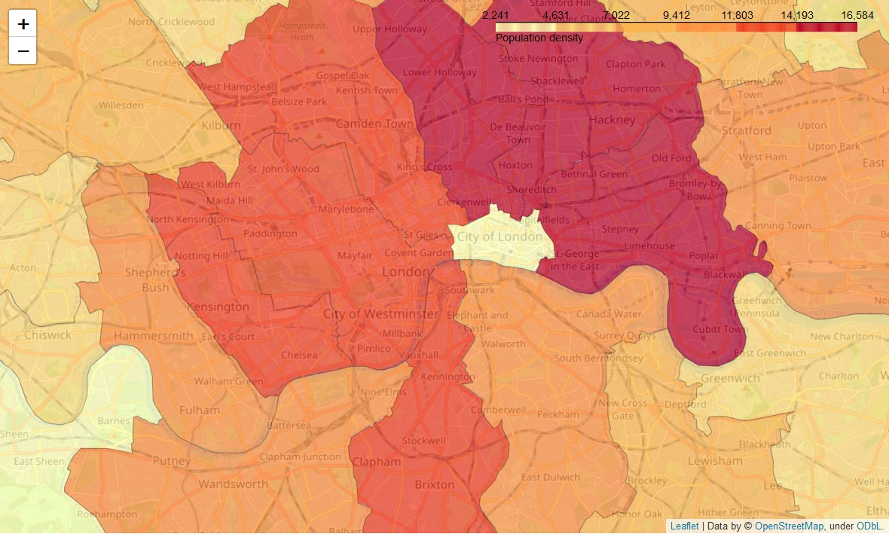
Parts around Central London have maximum population density which would help in enabling maximum visibility
Insights: Borough level population density would help in triangulating areas where the first launch can take place
Boroughs Camden, Islington, Westminister around the City of London are among the highly population-dense areas that needs to be taken into consideration

Slide 4
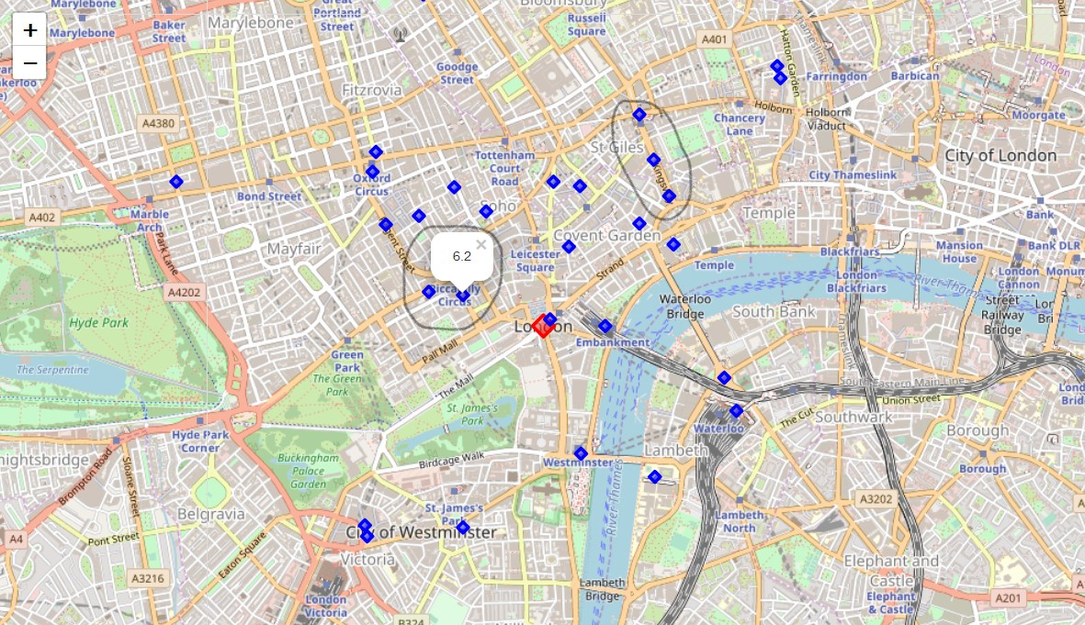
Competitive landscape suggests launching the first store around Kingsway road
Insights: Pencil marked areas show coffee shops with least density and low rated stores
Coffee stores in the Picadilly circus vicinity have ratings of 6.2 and 6.5 which are average, the vicinity is closer to the bridge thus can attract tourists and traveling citizens alike
Coffee stores on Kingsway road have ratings 5.6, 5.7 and 6.7 which are below average. It’s an important road lying in the borough with maximum population density and hence would be the ideal location

Slide 5
Final recommendations and further directions
We have been able to triangulate the first launch of the store to Kingsway
Higher population density would give us maximum visibility as we launch our first store in London, this will help in gathering more feedback quickly and understand customer sentiments in volume and quickly
Customers/coffee lovers who would like to explore coffee shops in and around Kingsway would have a higher chance to go for an untested and new coffee shops as compared to lower rated coffee shops in the same area
The immediate next step would be to segment the boroughs into clusters based on selected factors
Procuring the relevant factors defining the demographic of Boroughs
Using K-means clustering technique to cluster the Boroughs into cluster, this can be further used to replicate success from one Borough to another or explore and bring other demographic factors into consideration in case of a failure
This would ultimately help us analyze the appeal of the coffee shop across demographics

Slide 6
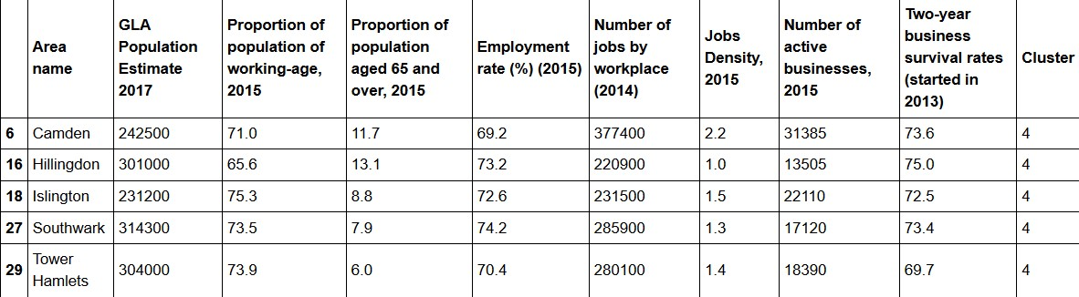
Using K-means clustering to cluster the boroughs (demonstrative)
Above illustration depicts a cluster (number 4) consisting of 5 Boroughs based on demographic factors (columns)
Relevant factors were chosen that directly impacts the coffee businesses such as Employment rate, 2-year business survival rates and population of working age

